Slide 1
Types, Objects, and Namespaces

Slide 2
Almost every ingredient you’ll need to use to create a web application is, on some level, really a kind of object.
You’ll see the types of objects .NET allows, how they’re constructed, and how they fit into the larger framework of namespaces and assemblies.

Slide 3
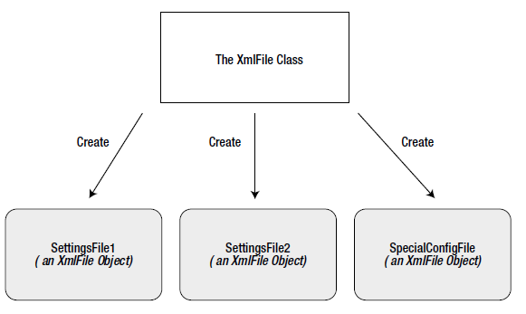
Understanding Classes
Classes are used to create objects

Slide 4
Classes interact with each other with the help of three key ingredients:
Properties
Methods
Events
For the most part, however, you’ll be using prebuilt classes from the .NET class library, rather than programming your own.

Slide 5
Shared and Instance Members
Shared members can be accessed by their class name
Example, using the shared property DateTime.Now to retrieve a DateTime object.
Don’t need to create a DateTime object first.
Example,
' Get the current date using a shared property.
' Note that you use the type name DateTime.
Dim myDate As DateTime = DateTime.Now
' Use an instance method to add a day.
' Note that you need to use the object name myDate.
myDate = myDate.AddDays(1)
' The following code makes no sense.
' It tries to use the instance method AddDays() with the class name DateTime!
myDate = DateTime.AddDays(1)

Slide 6
A Simple Class
Example,
Public Class Product
Private name As String
Private price As Decimal
Private imageUrl As String
End Class

Slide 7
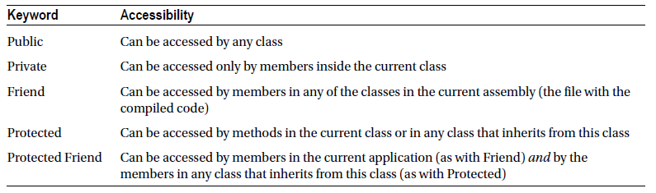
Accessibility Keywords
Accessibility keywords apply to member variables, methods, properties, and events.

Slide 8
Creating an Object
Example,
Dim saleProduct As New Product()
' Optionally you could do this in two steps:
' Dim saleProduct As Product
' saleProduct = new Product()

Slide 9
To release the saleProduct reference,
saleProduct = Nothing
Objects are automatically released when the appropriate variable goes out of scope.

Slide 10
To call a function that generates an object for you, and then use the object that’s returned from the function:-
Example 1,
' Declare but don't create the product.
Dim saleProduct As Product
' Call a function that accepts a numeric product ID parameter,
' and returns a Product object.
' Assign the Product object to the saleProduct variable.
saleProduct = FetchProduct(23)

Slide 11
Example 2,
Dim saleProduct As Product = FetchProduct(23)

Slide 12
Adding Properties
Accessors usually have two parts:-
The Get accessor allows your code to retrieve data from the object.
The Set accessor allows your code to set the object’s data.

Slide 13
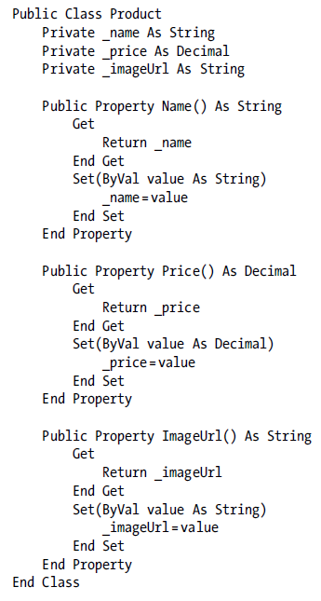
Example,

Slide 14
The client can now create and configure an instance of the class by using its properties and the familiar dot syntax.
Example,
Dim saleProduct As New Product()
saleProduct.Name = "Kitchen Garbage"
saleProduct.Price = 49.99D
saleProduct.ImageUrl = "http://mysite/garbage.png"

Slide 15
You can create properties that can be read but not set (which are called read-only properties), and you can create properties that can be set but not retrieved (called write-only).
Example,
Public ReadOnly Property Price() As Decimal
Get
Return _price
End Get
End Property

Slide 16
Using Automatic Properties
Properties that do nothing except set or get the value of a private member variable.
Example,
Public Class Product
Public Property Name As String
Public Property Price As Decimal
Public Property ImageUrl As String
End Class

Slide 17
Adding a Method
Methods are simply procedures or functions that are built into your class.
Example,
Public Class Product
' (Additional class code omitted for clarity.)
Public Function GetHtml() As String
Dim htmlString As String = " <h1> " & Name & "</h1> <br />" &
" <h3> Costs: " & Price.ToString() & "</h3> <br />" &
" <img src = '" & ImageUrl & "' />"
Return htmlString
End Function
End Class

Slide 18
Adding a Constructor
A constructor is a method that automatically runs when an instance is created. In VB, the constructor is always a method with the name New().
Example,
Public Class Product
' (Additional class code omitted for clarity.)
Public Sub New(ByVal name As String, ByVal price As Decimal)
Me.Name = name
Me.Price = price
End Sub
End Class

Slide 19
The previous example shows overlapping variables that share the same name
If you type Price, it assumes you mean the price parameter, not the Price property. To access the Price property, you need to use the Me keyword.
To use the Product class constructor,
Dim saleProduct As New Product("Kitchen Garbage", 49.99D)

Slide 20
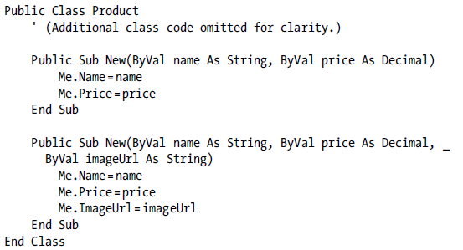
Constructors can be overloaded with multiple versions
Example,

Slide 21
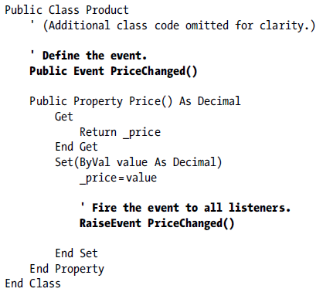
Adding an Event
Classes can also use events to notify your code.
To define an event in VB, you use the Event keyword, followed by the name of the event, and a list of parameters that the event will use.
Example,

Slide 22
Handling an Event
Step 1: Create a method called an event handler.
Step 2: Connect the event handler to the event.
In the Product example, the PriceChanged event has no parameters, so the event handler would look like following:-
Private Sub ChangeDetected()
' This code executes in response to the PriceChanged event.
End Sub

Slide 23
Two ways to connect an event handler:-
Example 1, using the AddHandler statement
Dim saleProduct As New Product("Kitchen Garbage", 49.99D)
' This connects the saleProduct.PriceChanged event to an event handling
' method called ChangeDetected.
AddHandler saleProduct.PriceChanged, AddressOf ChangeDetected
' Now the event will occur in response to this code:
saleProduct.Price = saleProduct.Price * 2

Slide 24
Example 2, Using Declarative Event Handling
Two steps:-
Step 1: Declare the event-firing object at the class level
Step 2: To hook up the event handler, use the WithEvents keyword and the Handles clause.

Slide 25
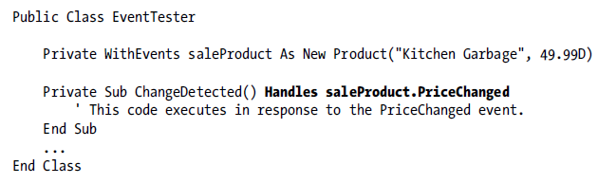
Example,

Slide 26
Value Types and Reference Types
Simple data types are value types, while classes are reference types.
A simple data type contains the actual information you put in it.
Object variables store a reference that points to a location in memory where the full object is stored.

Slide 27
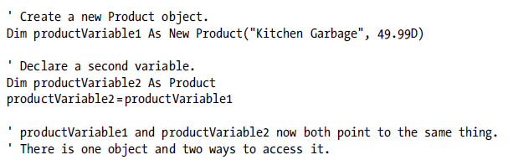
Assignment Operations
Example 1,
Example 2,

Slide 28
Equality Testing
When you compare value types (such as integers), you’re comparing the contents.
When you compare reference type variables, you’re actually testing whether they’re the same instance.
Example 1,
If integerA = integerB Then
' This is true as long as the integers have the same content.
End If
Example 2,
If productVariable1 Is productVariable2 Then
' This is True if both productVariable1 and productVariable2
' point to the same thing.
' This is False if they are separate objects, even if they have
' identical content.
End If

Slide 29
Passing Parameters by Reference and by Value
When you use pass-by-value parameters, the method receives a copy of the parameter data.
By default, all parameters are pass-by-value.
With pass-by-reference, the method accesses the parameter value directly.
Example 1,
Private Sub ProcessNumber(ByVal number As Integer)
number *= 2
End Sub
Example 2,
Private Sub ProcessNumber(ByRef number As Integer)
number *= 2
End Sub

Slide 30
If you use reference types, such as a Product object or an array, the entire object isn’t passed in the parameter. Instead, it’s just the reference that’s transmitted.
Example,
Private Sub ProcessProduct(ByVal prod As Product)
prod.Price *= 2
End Sub
The change shown in this example will affect the calling code.

Slide 31
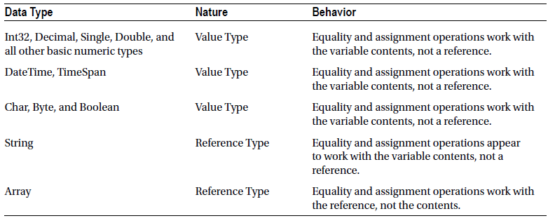
Common Reference and Value Types

Slide 32
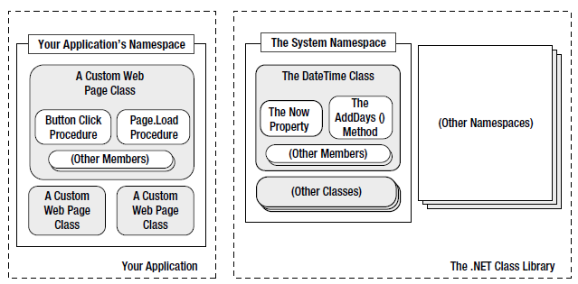
Understanding Namespaces and Assemblies
Every piece of code in .NET exists inside a .NET type (typically a class). In turn, every type exists inside a namespace.
A look at two namespaces,

Slide 33
Using Namespaces
Example 1,
Namespace MyCompany
Namespace MyApp
Public Class Product
' Code goes here.
End Class
End Namespace
End Namespace
Example 2,
Namespace MyCompany.MyApp
Public Class Product
' Code goes here.
End Class
End Namespace
The Product class is in the namespace MyCompany.MyApp

Slide 34
Importing Namespaces
Use the Imports statement.
Example,
Imports MyCompany.MyApp
Once you have done that, you can use this shortened syntax,
Dim salesProduct As New Product(...)

Slide 35
Assemblies
Assemblies are the physical files that contain compiled code.
A strict relationship doesn’t exist between assemblies and namespaces. An assembly can contain multiple namespaces. Conversely, more than one assembly file can contain classes in the same namespace.
The .NET classes are actually contained in a number of assemblies. For example, the basic types in the System namespace come from the mscorlib.dll assembly.
Many ASP.NET types are found in the System.Web.dll assembly.
By default, a wide range of .NET assemblies are automatically made available to ASP.NET applications. If you need to use additional assemblies, you need to define them in a configuration file for your website. This could be done by using the Website ä Add Reference command.

Slide 36
Generics
Generics allow you to create classes that are parameterized by type.
An example is the generic List collection class.
You must lock it into a specific type whenever you instantiate a List object. To do this, you specify the class you want to use in parentheses, preceded by the word Of.
Example,
' Create the List for storing Product objects.
Dim products As New List(Of Product)()
' Add several Product objects.
products.Add(product1)
products.Add(product2)
products.Add(product3)
' This line fails. In fact, it won't even compile.
products.Add("This string can't be inserted.")
Many more collections that use generics can be found in the System.Collections.Generic namespace.

